Slide 1
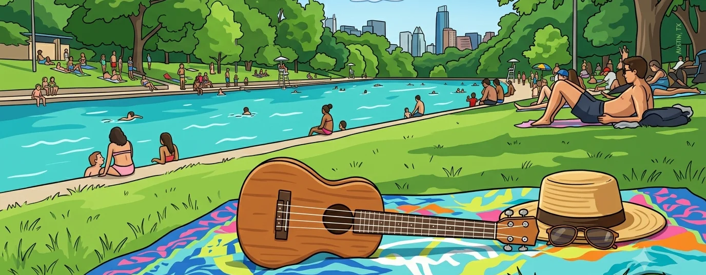












It’s Still Rock and Roll to Me
Billy Joel, 1980
Chords in this song:
Strum for this song:
>
>
Revised July 4, 2026

Slide 2
Intro
Next:
C
’ What’s the matter …

Slide 3

Verse 1 (1 of 2)
What’s the matter with the clothes I’m wearing?
Can’t ya tell that your tie’s too wide?
Next:
C
’ Maybe I should buy …

Slide 4
Verse 1 (2 of 2)
Maybe I should buy some old tab collars?
Welcome back to the age of jive
Next:
Em
’ Where have you been …

Slide 5
Chorus 1 (1 of 2)
Where have you been hidin’ out lately, honey?
You can’t dress trashy till you spend a lot of money
Chords sharing 1 strum pattern, 2 beats each
Next:
C
’ Everybody’s talkin’ …

Slide 6
Chorus 1 (2 of 2)
Everybody’s talkin’ ’bout the new sound. Funny, but
it’s still rock and roll to me.
Next:
C
’ What’s the matter …

Slide 7
Verse 2 (1 of 2)
What’s the matter with the car I’m driving?
Can’t ya tell that it’s out of style?
Next:
C
’ Should I get a …

Slide 8
Verse 2 (2 of 2)
Should I get a set of white wall tires?
Are you gonna cruise the miracle mile?
Next:
Em
’ Nowadays you can’t be …

Slide 9
Chorus 2 (1 of 2)
Nowadays you can’t be too sentimental.
Your best bet’s a true baby blue Continental.
Next:
C
Hot funk, cool punk …

Slide 10
Chorus 2 (2 of 2)
Hot funk, cool punk, even if it’s old junk,
it’s still rock and roll to me.
Next:
G
Oh, it doesn’t matter …

Slide 11
Bridge 1 (1 of 3)
Oh, it doesn’t matter what they say in the papers,
Cause it’s always been the same old scene.
Next:
G
Well, there’s a new …

Slide 12
Bridge 1 (2 of 3)
Well, there’s a new band in town,
but you can’t get the sound
Next:
E7
from a story in a …

Slide 13

Bridge 1 (3 of 3)
from a story in a maga-zine
aimed at your average teen.
Single
down
strum
Next:
C
’ How about a pair …

Slide 14
Verse 3 (1 of 2)
How about a pair of pink sidewinders
and a bright orange pair of pants?
Next:
C
’ Well, you could really …

Slide 15
Verse 3 (2 of 2)
Well, you could really be a Beau Brummel baby,
If you just give it half a chance.
Next:
Em
’ Don’t waste your …

Slide 16
Chorus 3 (1 of 2)
Don’t waste your money on a new set of speakers.
You get more mileage from a cheap pair of sneakers.
Next:
C Em
Next phase, new wave …

Slide 17
Chorus 3 (2 of 2)
Next phase, new wave, dance craze, anyways,
it’s still rock and roll to me.
Next:
G
Da da daaa …

Slide 18
Bridge 2 – Instrumental / scat (1 of 3)
Da-da daaa da-da-da-da da-da-da-da daaaa
da-da di-da-di-da di-da-da-da da-daaaaaaaa.
Next:
G
Da da daaa ……

Slide 19
Bridge 2 (2 of 3)
Da-da daaa da-da-da-da da-da-da-da daaaa
da-da di-da-di-da-di-da-da-da daaaaaaa
Next:
Eb
Da-da-da-da daaa …

Slide 20
Bridge 2 (3 of 3)
Da-da-da-da da-daaaa
Da-da-da-da da-daaaa Ooooooooooohhhhhhhhhh
[HOLD 8 beats]
Next:
C
’ What’s the matter …

Slide 21
Verse 4 (1 of 2)
What’s the matter with the crowd I’m seeing?
Don’t ya know that they’re out of touch?
Next:
C
’ Should I try to be a …

Slide 22
Verse 4 (2 of 2)
Should I try to be a straight ’A’ student?
If ya are, then you think too much.
Next:
Em
’ Don’t you know …

Slide 23
Chorus 4 (1 of 2)
Don’t you know about the new fashion, honey?
All you need are looks and a whole lotta money.
Next:
C
It’s the next phase …

Slide 24
Chorus 4 (2 of 2)
It’s the next phase, new wave, dance craze, anyways
it’s still rock and roll to me.
Next:
C Em
Everybody’s talkin’ …

Slide 25
Ending
Everybody’s talkin’ ’bout the new sound. Funny,
but it’s still rock and roll to me.
[HOLD]
Thanks y’all!!!

Slide 26
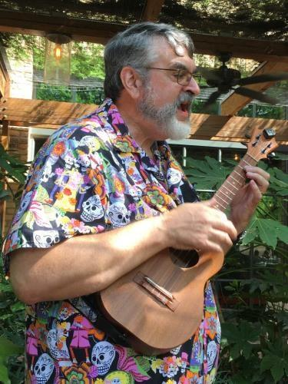
In memory of Kevin Jolly -- founder and inspiration of Tuesday Ukes

